Slide 1
Evolution of management thought

Slide 2
Evolution of Management Theories
1.The Classical theory of management
Scientific Management
Bureaucratic Management
Administrative Management
2.Neo-Classical Theory
Human Relations
Behavioral Science Approach
3.The Modern Management Theories
Quantitative Approach
System Approach
Contingency Approach
Operational Approach

Slide 3
Early approaches to Management
The Industrial Revolution, which began in Europe in the mid-1700s, was the starting point for the development of management concepts and theories.

Slide 4
Classical Approach
Classical management can be divided into three separate schools:-
Scientific management – F.W. Taylor
Administrative theory – Henry Fayol
Bureaucratic management – Max Weber

Slide 5
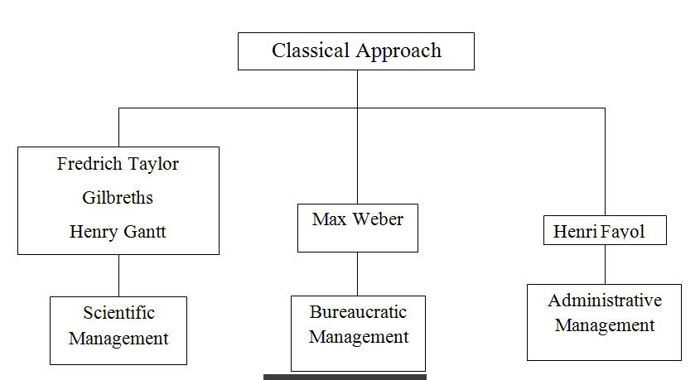

Slide 6
Overview of classical theories
Approach | Rationale | Focus
Scientific management | One best way to do each job | Job level
Administrative principles | One best way to put an organization together | Organizational level
Bureaucratic organization | Rational and impersonal organizational arrangements | Organizational level

Slide 7
Classical Approach
These views are labeled as classical because they form the foundation for the field of management thought.

Slide 8
Scientific management
It is an approach that emphasizes the scientific study of work methods to improve the efficiency of workers.
It became popular in 1900s.

Slide 9
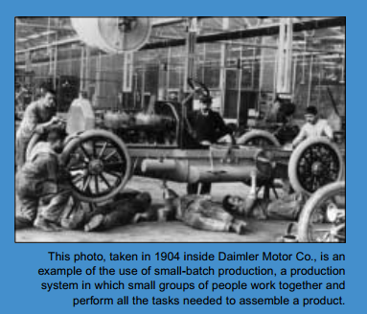

Slide 10
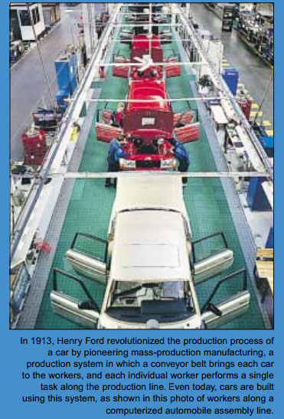
Notes:
<number>

Slide 11
Scientific management
F.W. Taylor was known as the ‘father of scientific management.’
Midvale Steel Co.
Soldiering
To counter the soldiering problem Taylor developed the science of Management.

Slide 12
Four Principles of Scientific Management
1) Study the ways jobs are performed now and determine new ways to do them.
Gather detailed time and motion information.
Try different methods to see which is best.
BnR-Peng.Manajemen-Chap-05
<number>
Notes:
<number>

Slide 13

Four Principles of Scientific Management
2) Codify the new methods into rules.
Teach to all workers the new method.
BnR-Peng.Manajemen-Chap-05
<number>
Notes:
<number>

Slide 14
Four Principles of Scientific Management
Select workers whose skills match the rules.
Establish fair levels of performance and pay a premium for higher performance.
Workers should benefit from higher output
BnR-Peng.Manajemen-Chap-05
<number>
Notes:
<number>

Slide 15
F.W.Tayler’s Contribution(1856-1915)
Father of Scientific Management
Principles of F.W.Tayler’s Management
Scientific task setting based on time, motion and fatigue study.
Fitting the “right person for the right job” by proper selection, training and placement of personnel.
Improvement in work by
Standardisation of tools and equipment
Improvement in work environment

Slide 16
Employers and employees should not feel that they are exploiting each other(Mental revolution)
Differential piece rate wage system to distinguish between efficient and inefficient workers( Tayler’s Differential Piece Rate Plan)
Intelligent investigation and analysis of the different unit of the business.
Scientific study of each unit of the business.
Separation of the planning and execution based on specialisation.

Slide 17
Frank and Lillian Gilbreth
He concentrated on Motion Study and suggested the first definition-“motion study as the science of eliminating wastefulness resulting from unnecessary, ill directed and inefficient motions”
He developed Process Chart-Over all picture of all activities in a chart form.
BnR-Peng.Manajemen-Chap-05
<number>
Notes:
<number>

Slide 18
Studied fatigue caused by lighting, heating, and the design of tools and machines.
Time and motion studies
Breaking up each job action into its components.
Finding better ways to perform the action.
Reorganizing each job action to be more efficient.

Slide 19
Contributions of Henry L.Gantt
Worked with F.W.Tayler
He Improved Taylor’s differential piece rate system
Task and Bonus Plan ((Provide extra wages for extra work)
He developed the daily balance chart (Gantt chart) output in one axis and time on the other axis.
Humanistic approach and industrial responsibility.

Slide 20
SCIENTIFIC MANAGEMENT
F.W.Tayler- Father of Scientific Management
Main contributors- F.W.Tayler, Frank Gilbreths, Gantt
Principles of Scientific Management
Replacement of old rule of thumb method
Scientific selection and training
Labor-Management co-operation(mental revolution)
Maximum output
Equal division of responsibility

Slide 21
Techniques of Scientific Management
Scientific task setting-fair day’s work
Work study-method, time, fatigue and motion study
Planning the task
Standardisation
Scientific selection and training
Differential piece-wage plan
Specialisation

Slide 22
Scientific management
The two major managerial practices that emerged from Taylor’s approach :-
Piece-rate incentive system
Time-and-motion study

Slide 23
Criticism of Scientific Management
Functional organization structure (An operator is controlled by eight foremen)– In practice and violates unity of command.
It concentrated on production management and ignores the area of Finance, Marketing, Accounting and Personnel.
Workers objected Tayler’s Differential piece wage plan
because wages of workers are not increased in direct proportion to the increase in productivity.
It undermined the human factor in industry. It resulted in monotony of job, loss of initiative, wage reductions, job insecurity etc.
Notes:
<number>

Slide 24
Limitations of scientific management
Scientific management focus on problems at operational level.
People are motivated only by material gains.
It ignored human desire for job satisfaction.

Slide 25
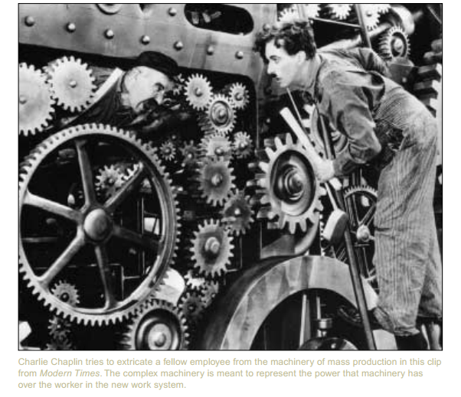

Slide 26
Administrative Theory
It focused on principles that could be used by managers to coordinate internal activities of organization.
Henry Fayol – French
According to Fayol, the business operations of an organization could be divided into 6 activities

Slide 27
Administrative Theory
The 6 activities are :-
Technical
Commercial
Financial
Security
Accounting
Managerial

Slide 28
Fayol’s 14 principles of Management
Division of work
Authority and responsibility
Discipline
Unity of command
Unity of direction
Subordination of the individual interest to the general interest.

Slide 29
Fayol’s 14 principles of Management
Remuneration
Centralization
Scalar chain
Order
Equity
Stability of tenure of personnel
Initiative
Espirit de corps

Slide 30
Bureaucratic Management
Max Weber
Major characteristics of Bureaucracy
Work specialisation and division of labour
Rules and regulations
Impersonality
Hierarchy of organization

Slide 31
Limitations of bureaucratic and administrative management
Not universally accepted principles.
Bureaucracy destroyed individual creativity and flexibility.
Important aspects of O.B. was ignored.
External and internal environment ignored.

Slide 32
Behavioral Approach
The behavioural school of management emphasized what the classical theorists ignores – The human element.

Slide 33
Elton Mayo : Focusing on Human Relations
Father of the Human Relations Approach
Western Electric’s Hawthorne Plant

Slide 34
Elton Mayo : Focusing on Human Relations
The experiments were conducted in four phases:
Illumination experiment
Relay assembly test room experiment
Interview phase
Bank wiring observation room experiment

Slide 35
Contributions of Hawthorne studies
The group is the key factor in job performance
Perceived meaning and importance of the work determine output
Workplace culture sets its own production standards

Slide 36
Criticism of Hawthorne studies
Critics felt that the conclusions were supported by little evidence.
The relationship made between satisfaction of workers and productivity was too simple.
The studies failed to focus on the atitudes if employees.

Slide 37
Abraham Maslow : Hierarchy of needs
People are motivated by a hierarchy of needs
His theory had three assumptions
All of us have needs which are never fulfilled
Through our actions we try to fulfill our unsatisfied needs
Needs can be classified into 5 types

Slide 38
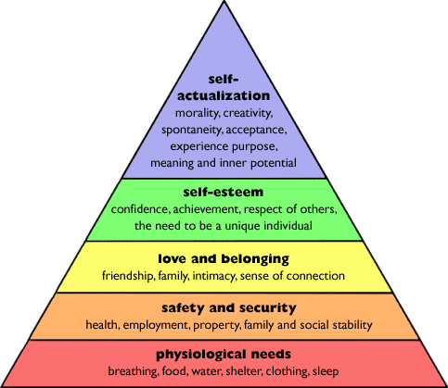

Slide 39
Abraham Maslow : Hierarchy of needs
According to Maslow, once needs at a specific level have been satisfied, they no longer act as motivators of behaviour.
Then individual strives to fulfill needs at the next level.

Slide 40
Douglas McGregor : Theory X and Theory Y
These theories reflect two extreme sets of belief that different managers have about their workers.
Theory X represents an essentially negative view.
Theory Y reflects a more positive view.

Slide 41
Chris Argris : Matching human and organizational development
Maturity –immaturity theory
Model I and Model II
Model I – Employees are manipulative and not willing to take risks

Slide 42
Quantitative approach
1. Management science
Another name for it is operations research
2. Operations management
3. Management information systems

Slide 43
Modern approaches to management
1. Systems approach
Organizations cannot exist in isolation
Four major components – Inputs, transformation process, output and feedback
Open and closed systems

Slide 44
Modern approaches to management
2. Contingency theory
Situational theory

Slide 45
Emerging Approaches in Management Thoughts
William Ouchi – theory Z
Conducted research on both American and Japanese management approaches
Theory Z involves providing job security to employees to ensure their loyalty
Quality management

